Slide 1
CSP Exercise
Use simplest backtracking

Slide 2
To Do:
Solve this problem basing yourself on the attached code, applying the simplest form of the backtracking recursive algorithm

Slide 3
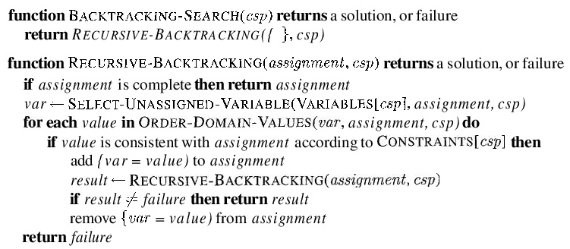
Simplest Backtracking Algorithm

Slide 4
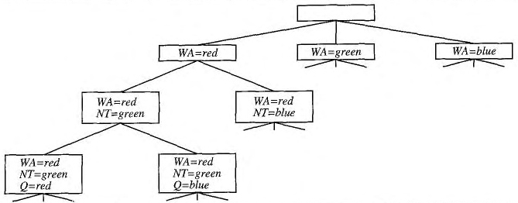
Color Map Backtracking Example

Slide 5
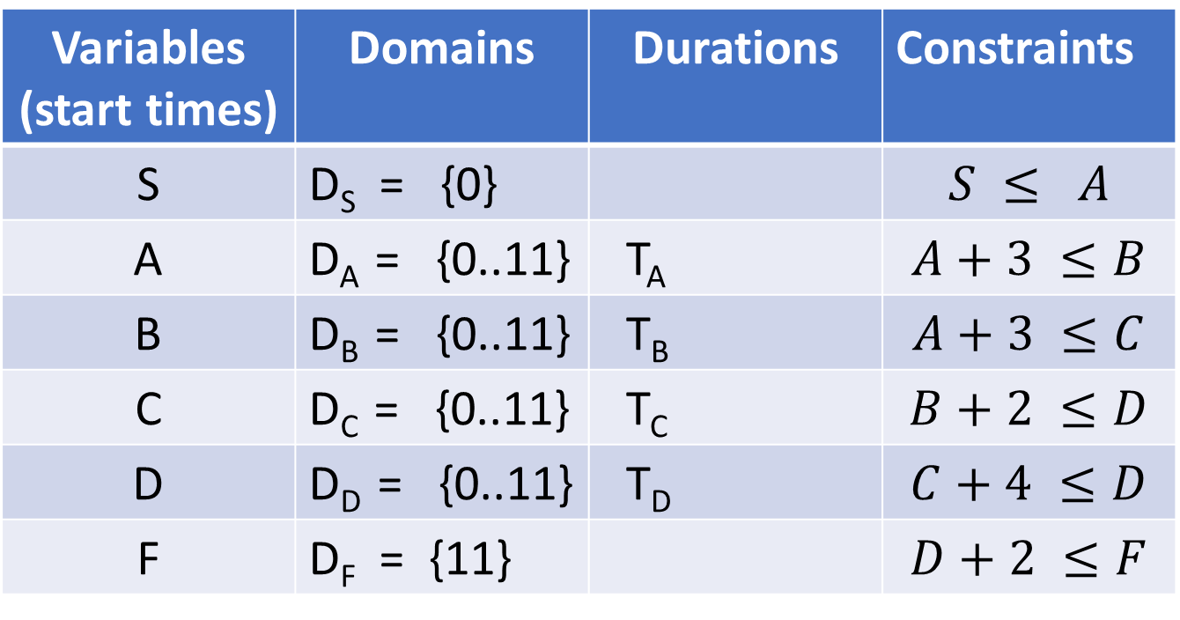
CSP – Solve for A, B, C, D, and F Using Simple Backtracking
A project that involves tasks T_{A}, T_{B}, T_{C}, T_{D}
Variables (start times) | Domains | Durations | Constraints
S | D_{S} = {0} |  | $$S ≤ A$$
A | D_{A} = {0..11} | T_{A} | $$A+3 ≤B$$
B | D_{B} = {0..11} | T_{B} | $$A+3 ≤C$$
C | D_{C} = {0..11} | T_{C} | $$B+2 ≤D$$
D | D_{D} = {0..11} | T_{D} | $$C+4 ≤D$$
F | D_{F} = {11} |  | $$D+2 ≤F$$

